Slide 1
Machine Learning and Financial Applications
Lecture 9
Robust Portfolio Optimization
Liu Peng
liupeng@smu.edu.sg

Slide 2
Black-Litterman Model
An advanced portfolio allocation framework that combines the Capital Asset Pricing Model (CAPM) equilibrium with investor-specific views to derive a set of optimal asset allocations.
Addresses the limitations of traditional mean-variance optimization by providing more stable and intuitive portfolio weights.
CAPM serves as the parameters of a prior distribution (assumed to be normal), and investor views as observed data.
Jointly, they form a posterior distribution on expected returns

Slide 3
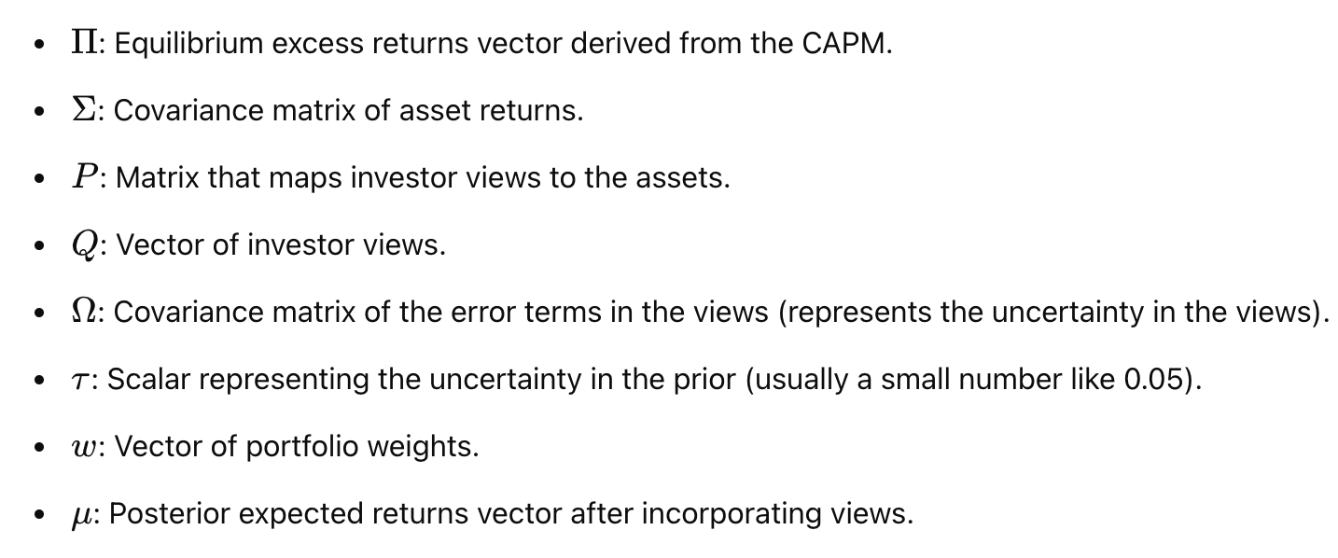
Key Components and Notations

Slide 4
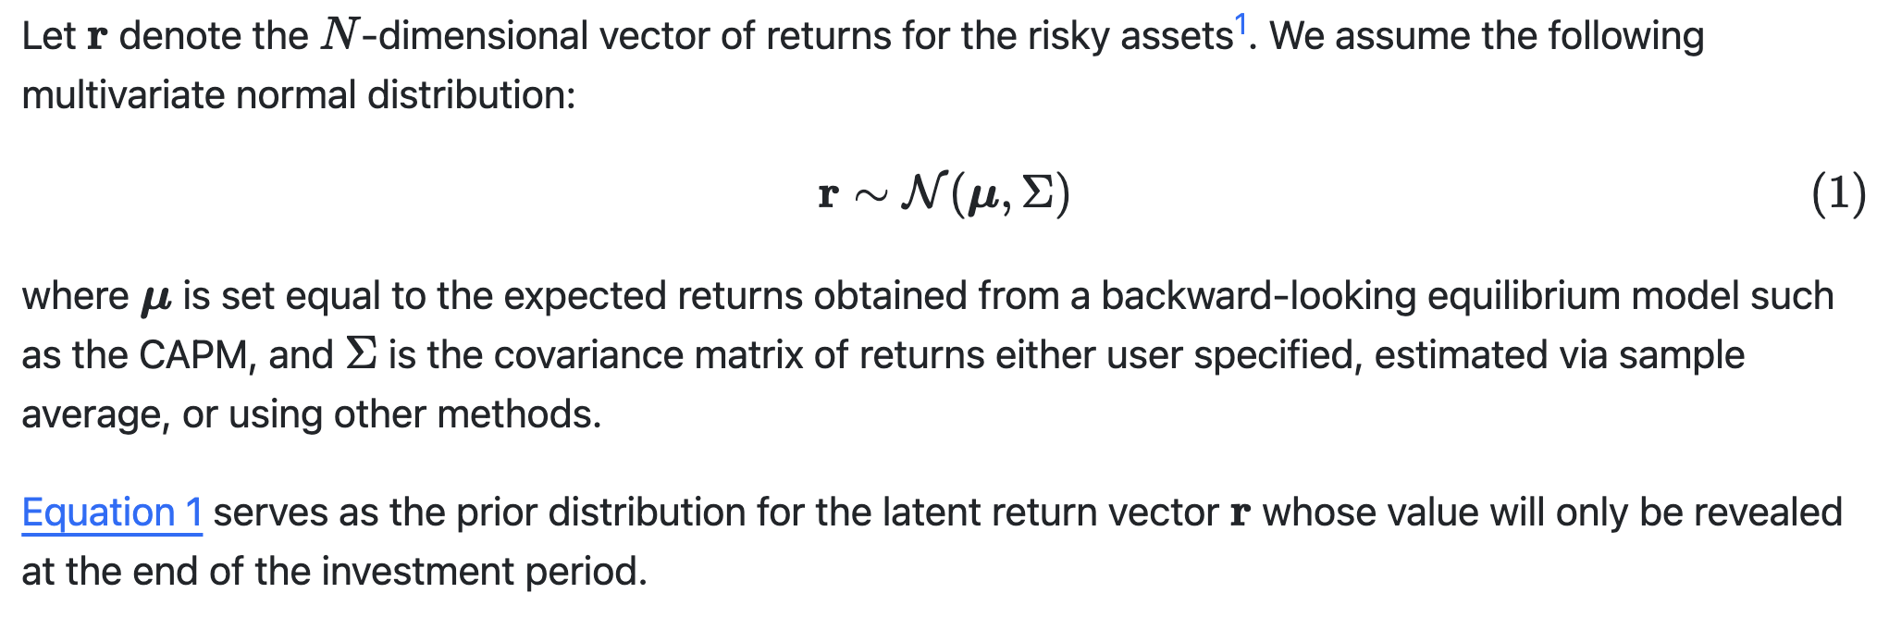
Equilibrium Model and Prior Distribution for Returns

Slide 5
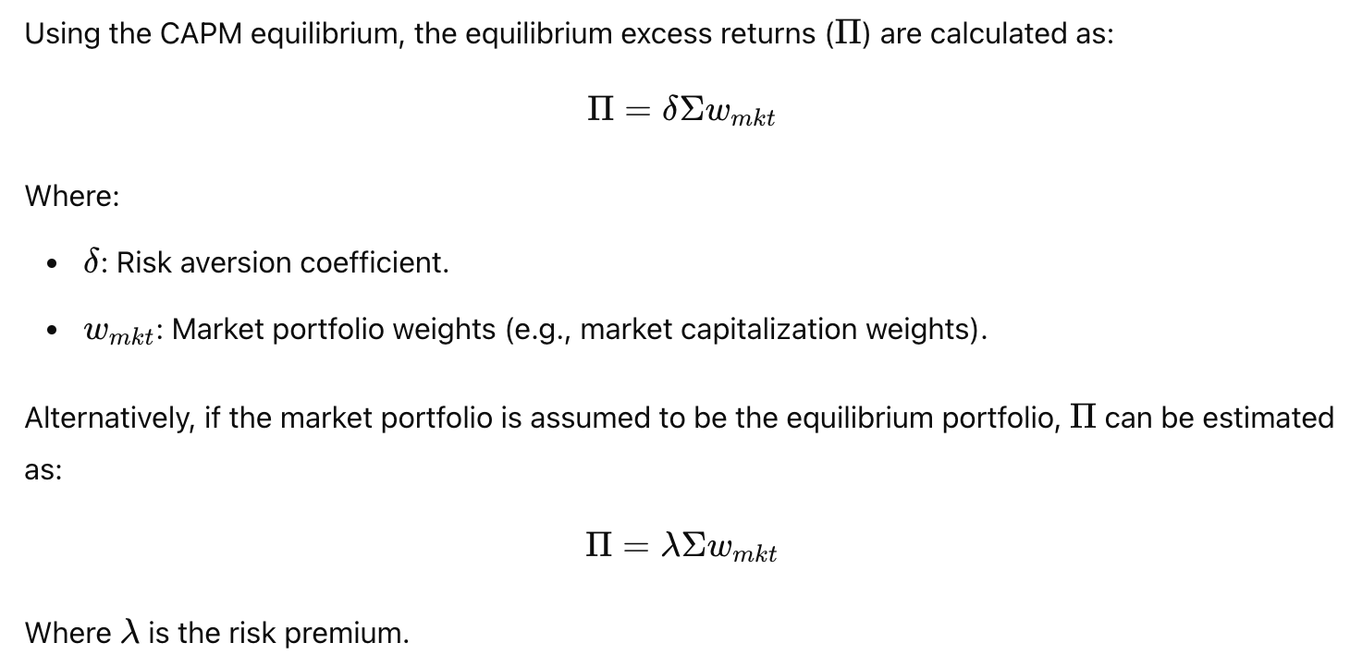
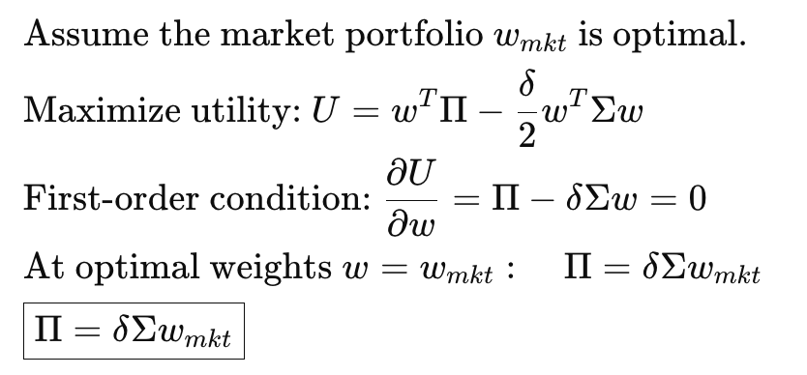
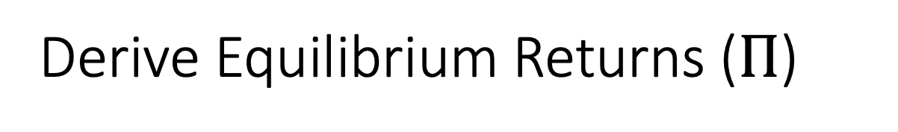
Derive Equilibrium Returns ($Π$)
(optional)

Slide 6
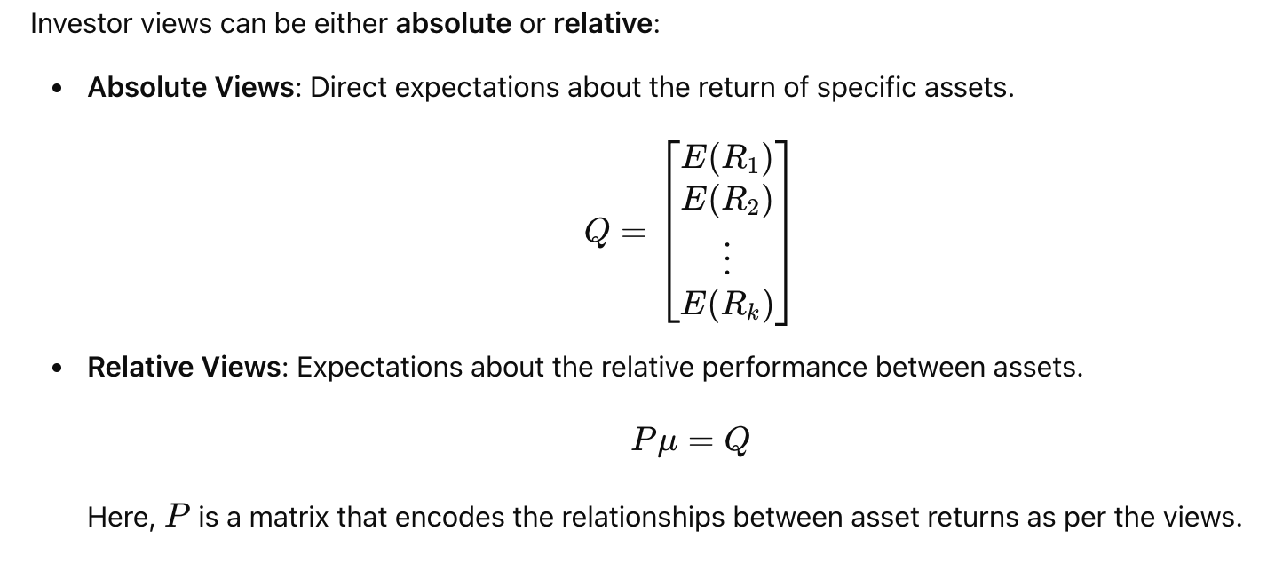
Specify Investor Views

Slide 7
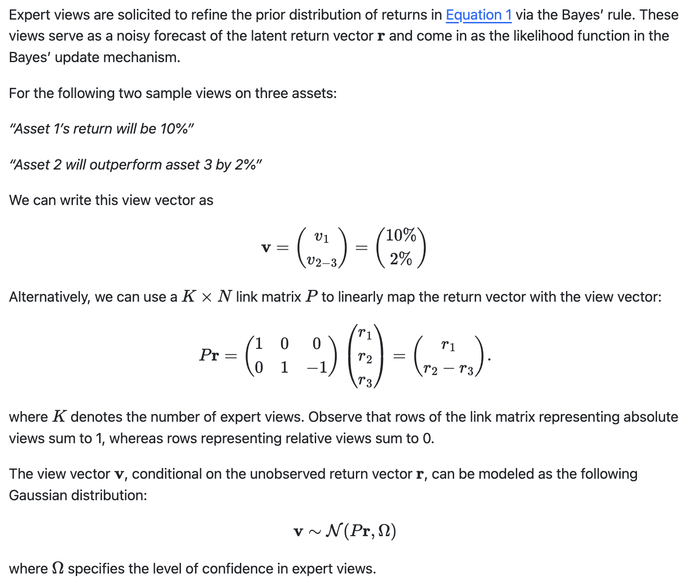
Investor Views Representation

Slide 8
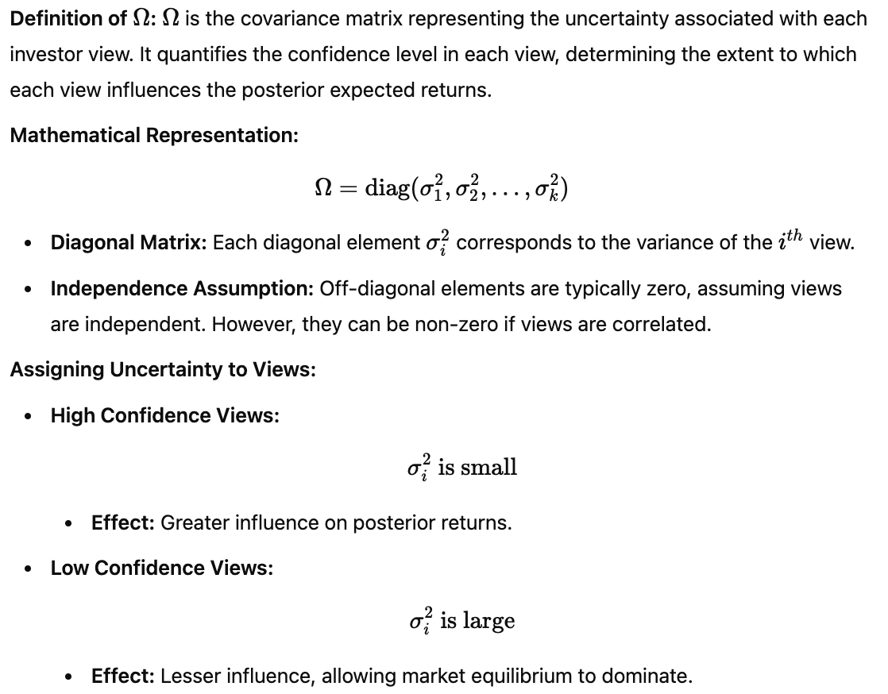
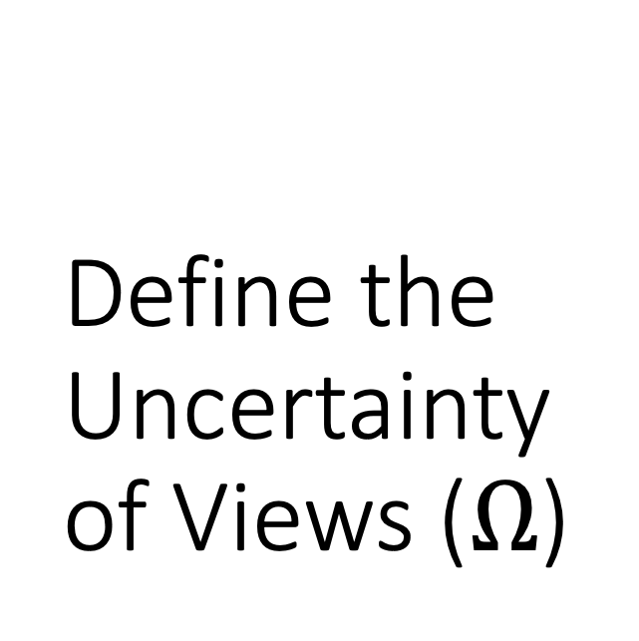
Define the Uncertainty of Views ($Ω$)

Slide 9
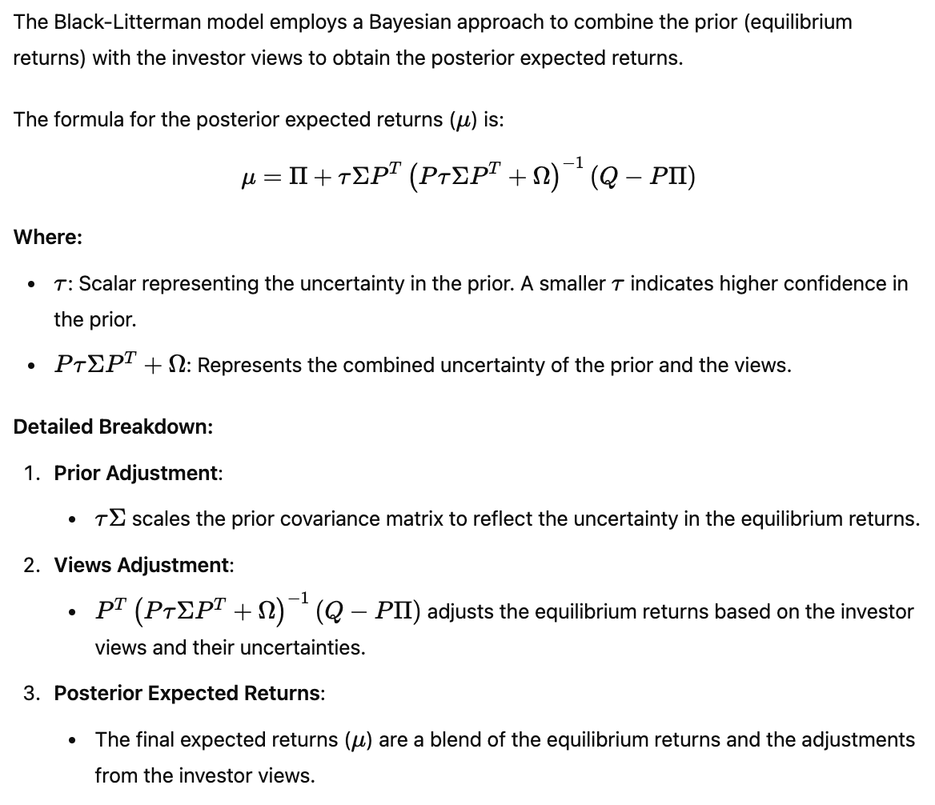
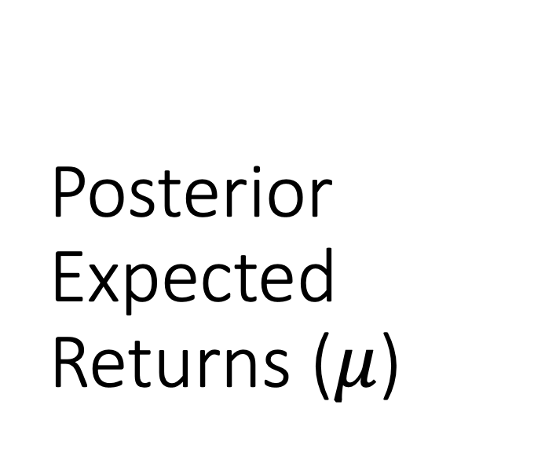
Posterior Expected Returns ($μ$)

Slide 10
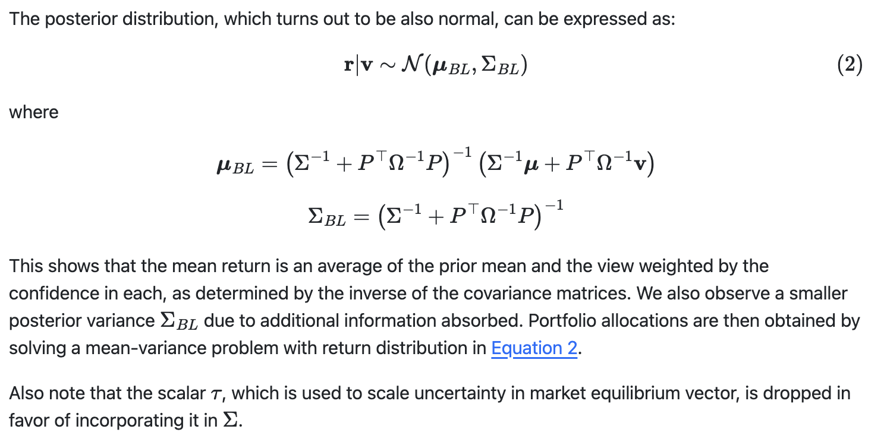
Posterior Return Distribution

Slide 11
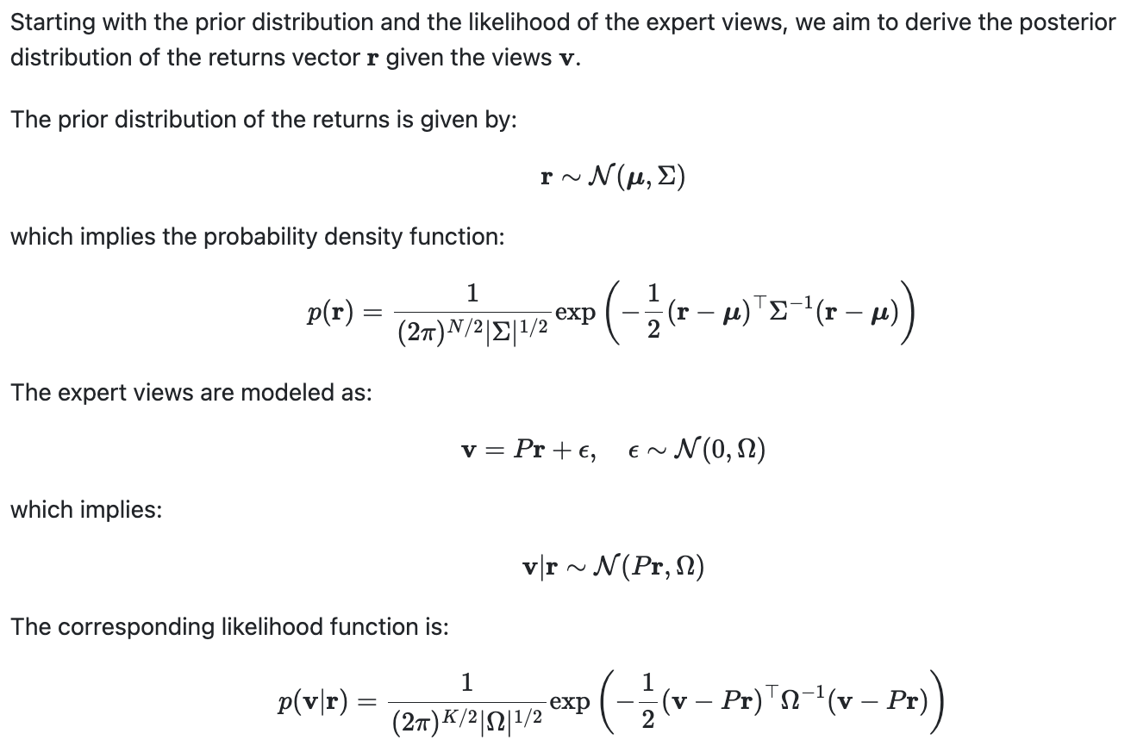
Deriving the Posterior Distribution 1 (optional)

Slide 12
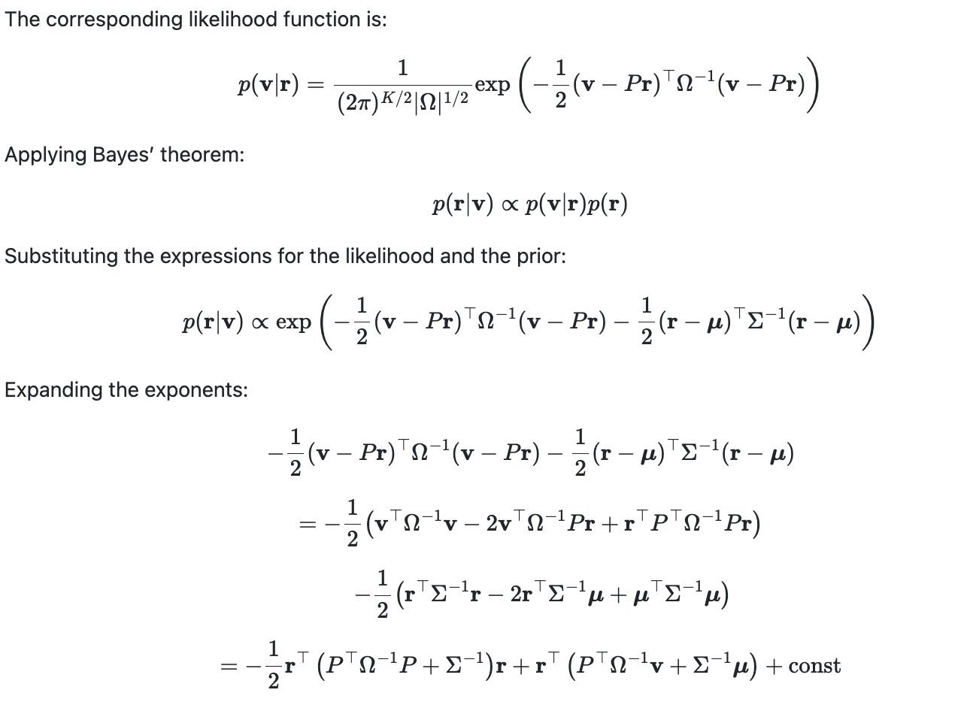
Deriving the Posterior Distribution 2 (optional)

Slide 13
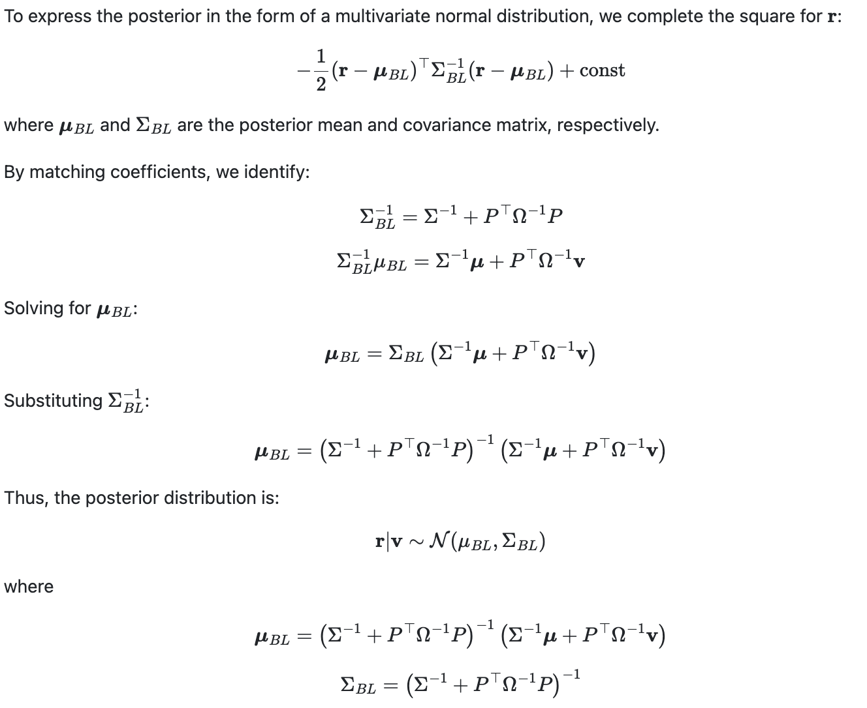
Deriving the Posterior Distribution 3 (optional)

Slide 14
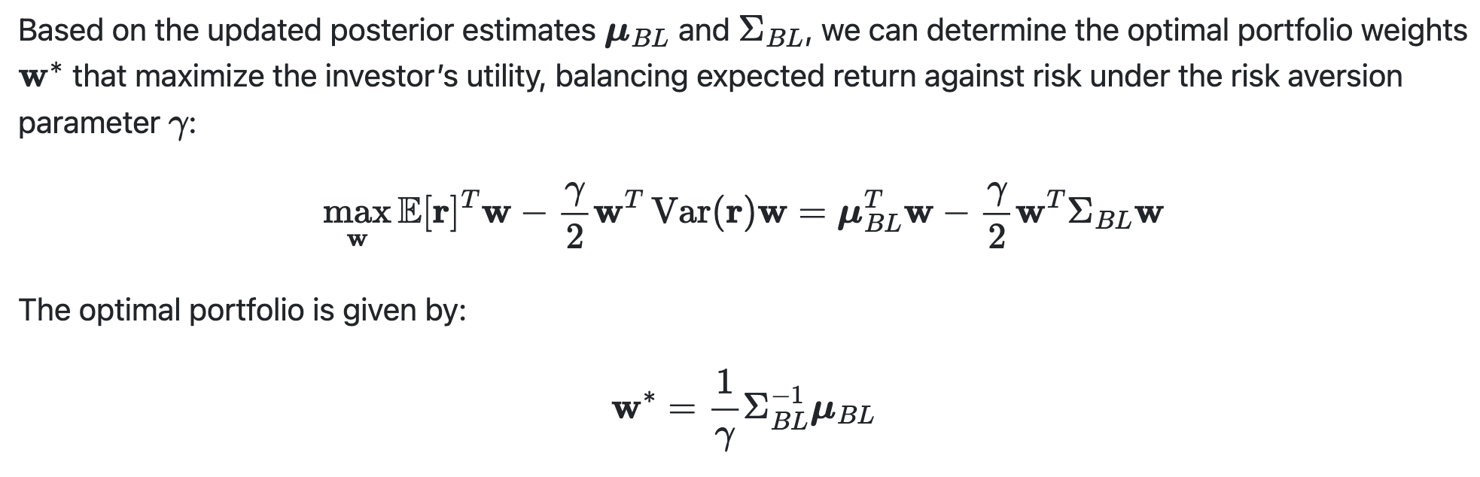
Optimal BL Portfolio

Slide 15
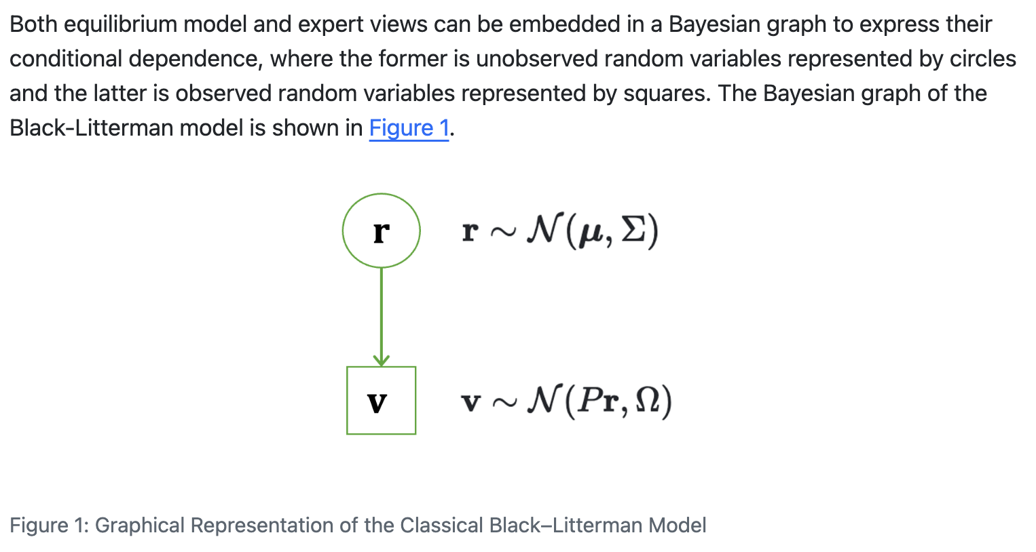
A Graphical Representation

Slide 16
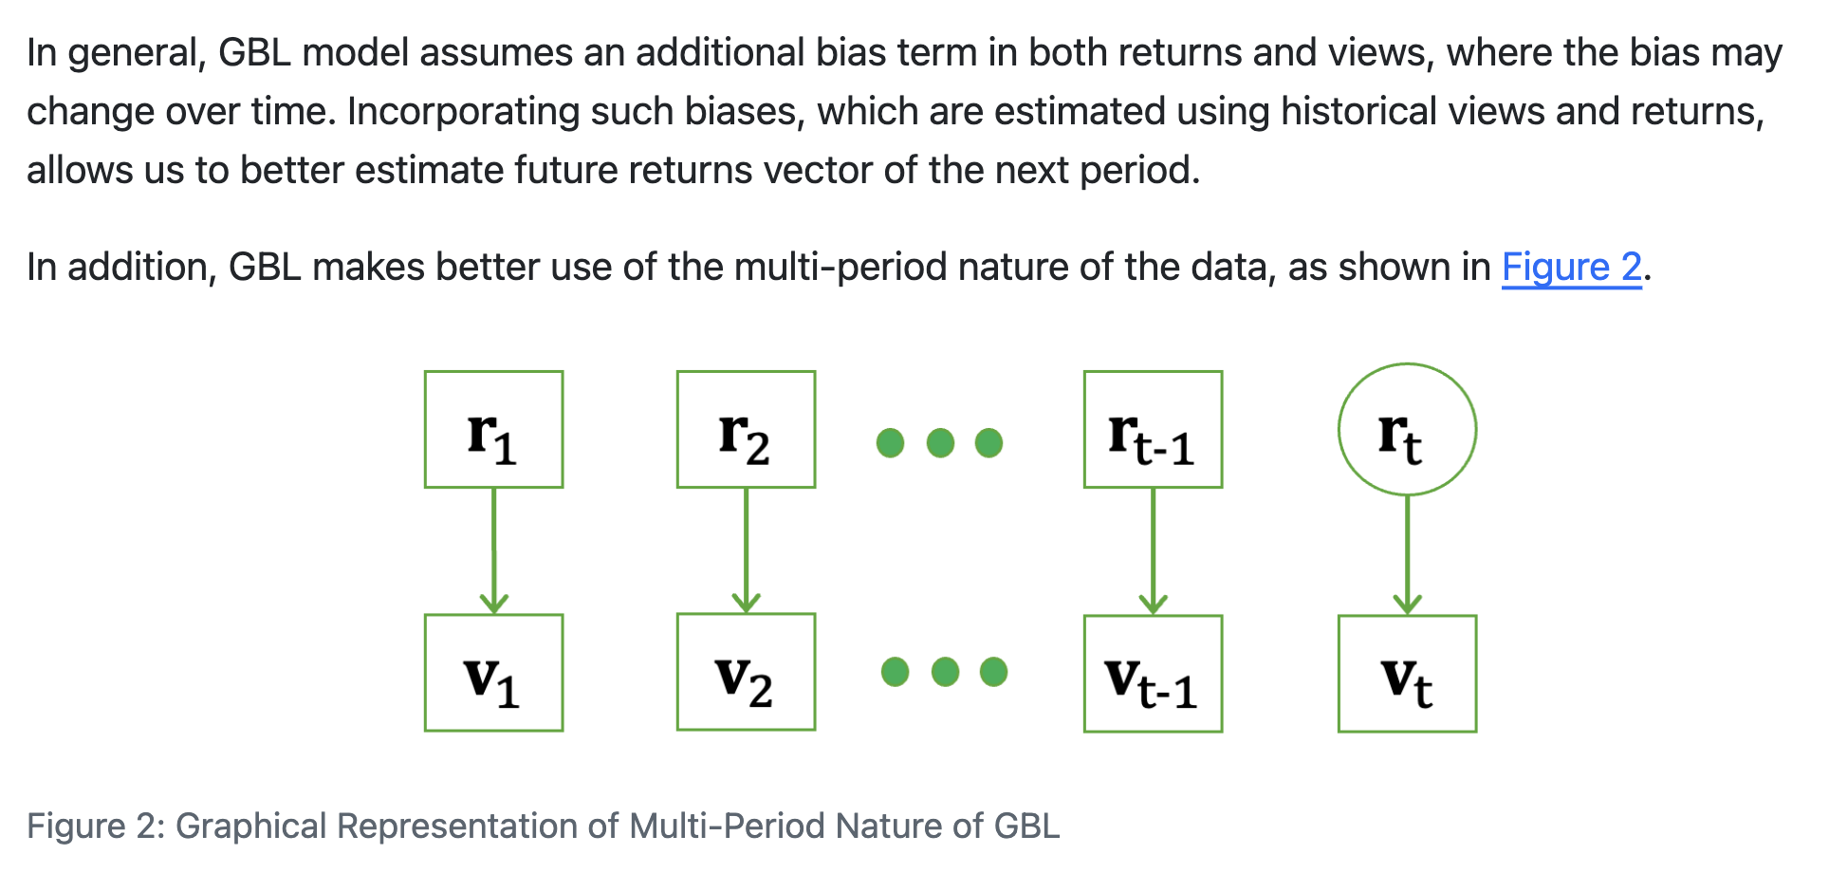
Generalized Black-Litterman Model

